Slide 1
Google Slides-The Basics
This is best seen by pressing the present button at the top of the screen.

Slide 2
General Navigation
Presentation Title
Google Slides Home Screen
Menu Toolbar
Saved Changes Notification
Present
Collaboration Tools
Ruler
Shortcut Toolbar
Slide Navigation Pane
Slide Pane
Notes

Slide 3
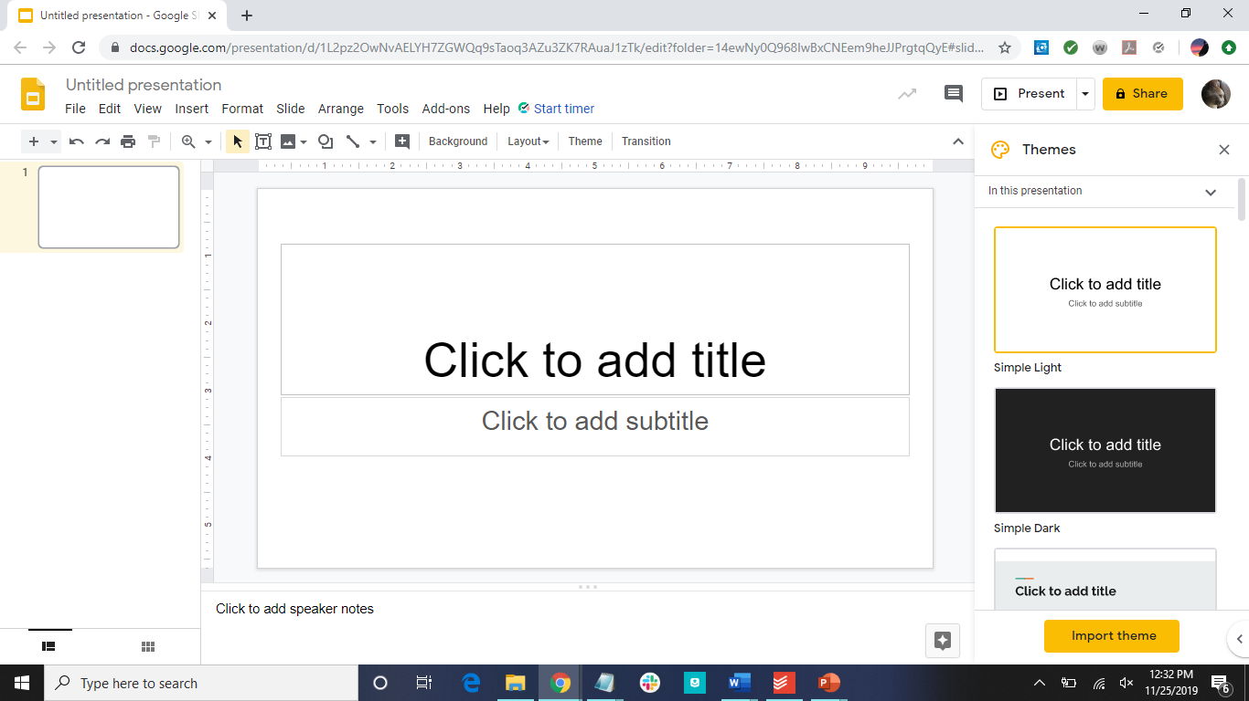

Title
Menu Toolbar
Navigate to Slide Home Page
Shortcuts Toolbar
Slide Pane
Collaboration and Presentation Tools
Themes Menu
Slide Navigation
Pane
Rulers
Notes

Slide 4
Choosing a Theme
Look through the Theme section
Click on the themes to preview them
How to Change the Theme After closing the section:
Click on the Slide Menu
Click on change theme
Choose theme

Slide 5
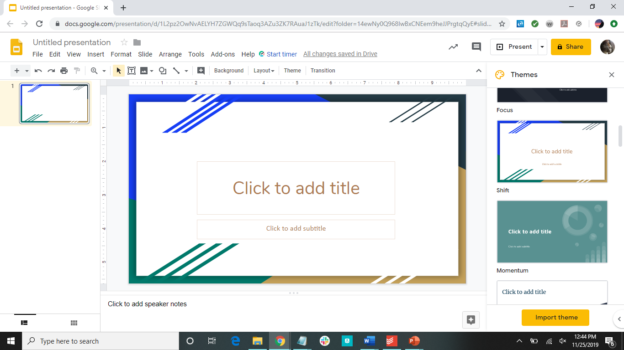
Saved Changes Notification

Slide 6
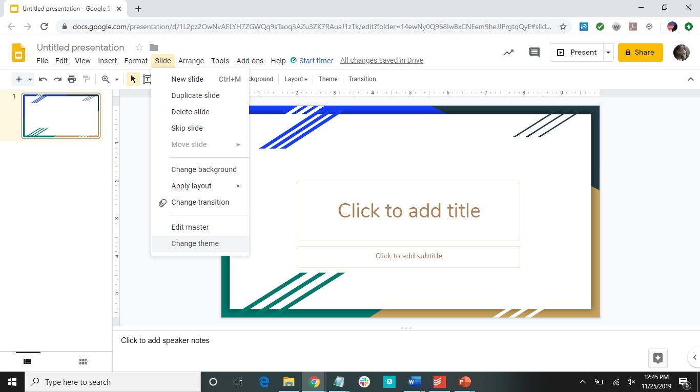

Slide 7
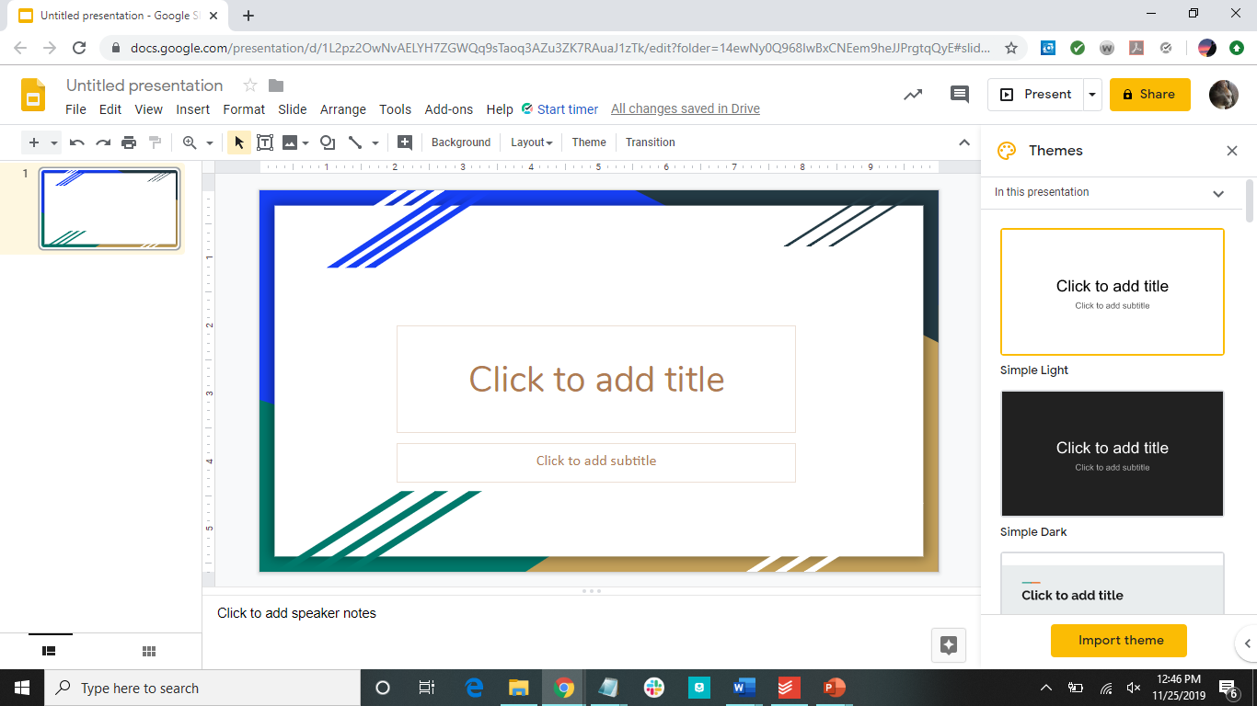

Slide 8
Zooming In and Out
Click on the zoom button
Click on the slide
Click on the zoom button again
Click on the arrow next to the zoom button
Click Fit or the percentage of zoom you want

Slide 9
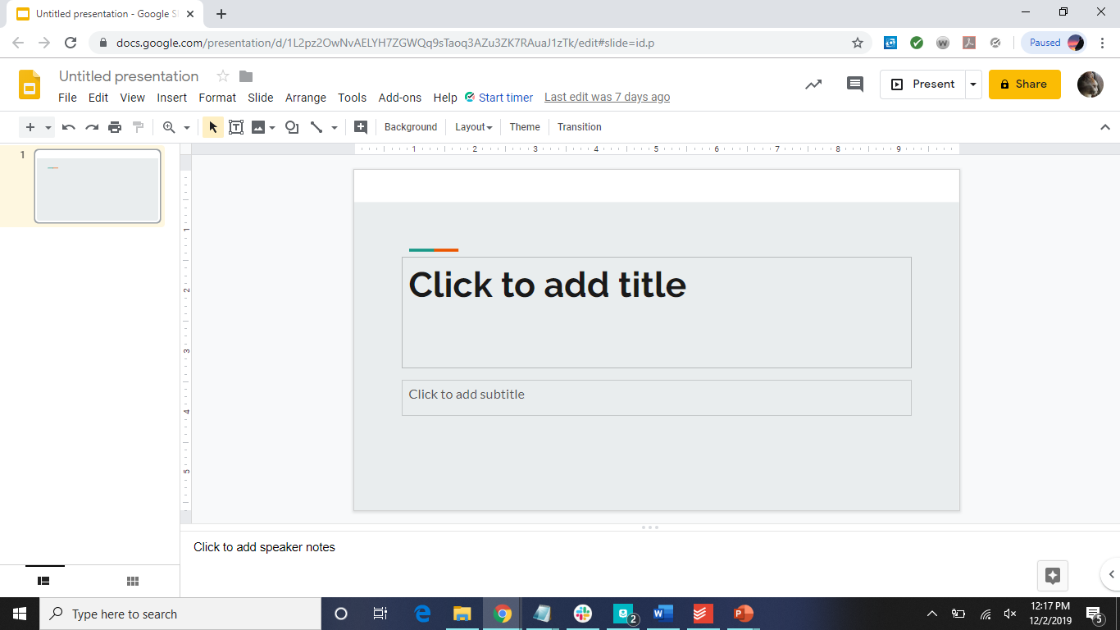
Zoom button

Slide 10
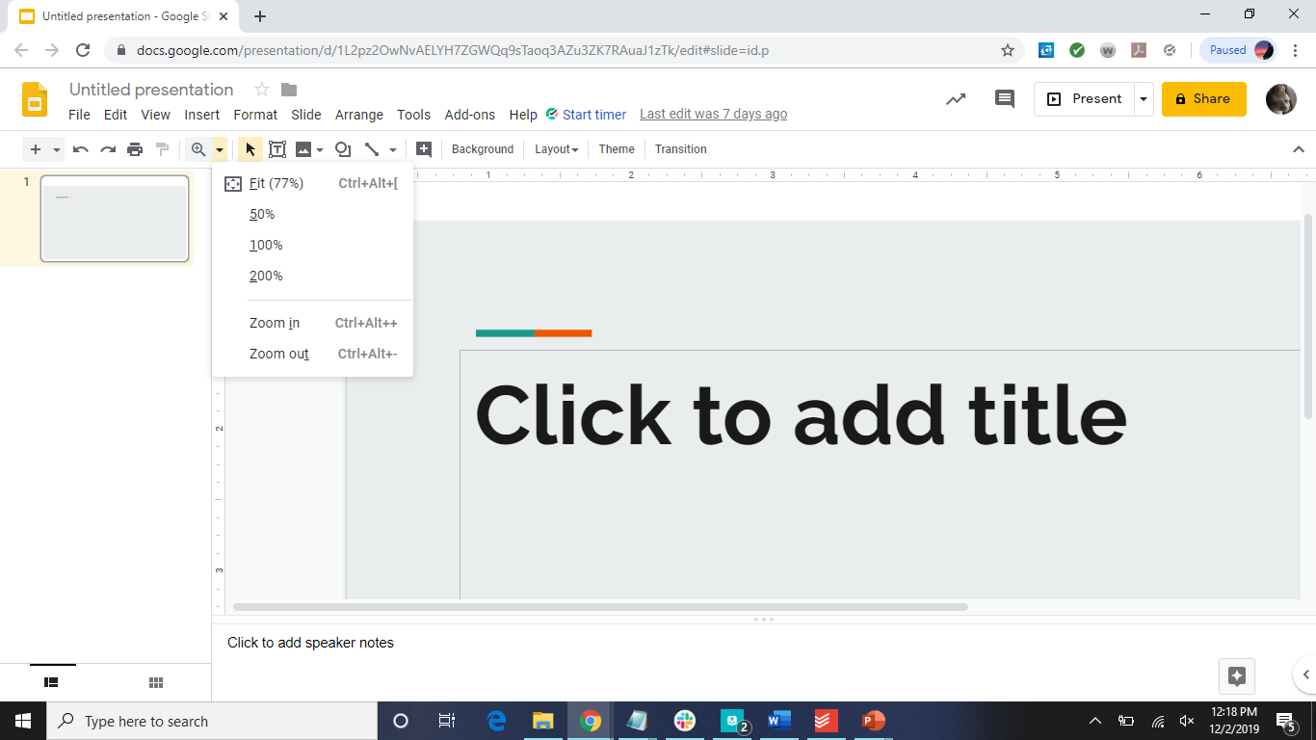
Fit button

Slide 11
How to Add a New Slide
Click on the arrow next to the “+”
Choose what slide layout you would like

Slide 12
New Slide

Slide 13
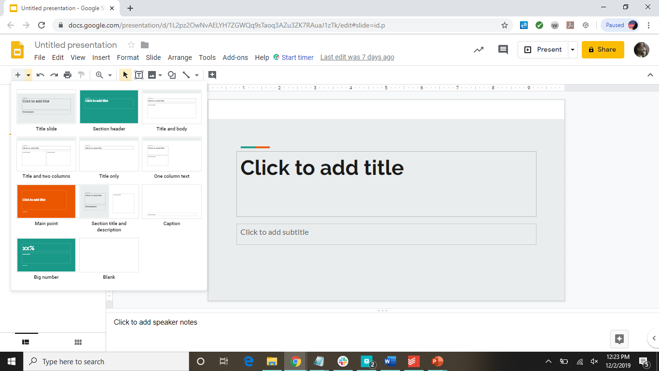
Choose which slide layout.

Slide 14
Slide Layouts
Title slide
Section header
Title and body
Title and two columns
Title only
One column text
Main point
Section title and description
Caption
Big number
Blank

Slide 15
How to Add Ideas
Enter to get a new line
Enter again or backspace to remove the bullet
Can also use text boxes to organize content

Slide 16
Text Basics
Font
Font Size
Font Style
Font Color
Insert Link and Add Comment
Align Text
Line Spacing
Bulleted and Numbered Lists
Decrease and Increase Indent
Clear Formatting

Slide 17
How to Insert Pictures
Click on the Insert tab
Click on Image
Choose where the image is

Slide 18
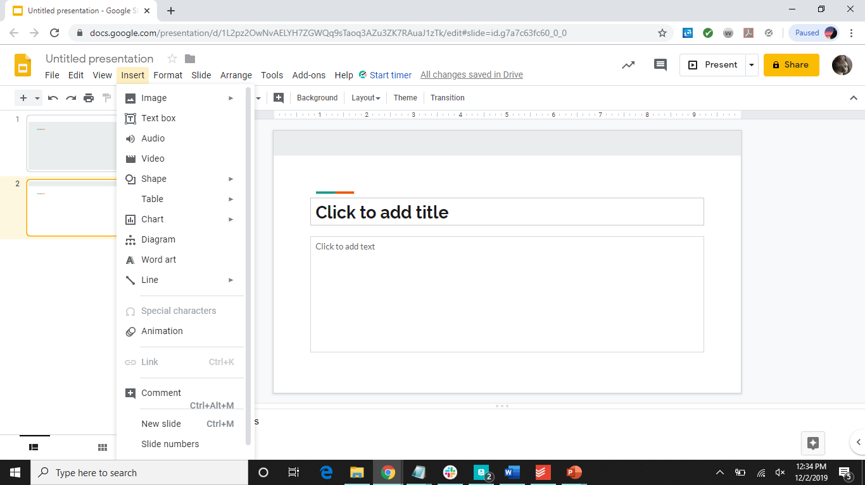
Click here

Slide 19
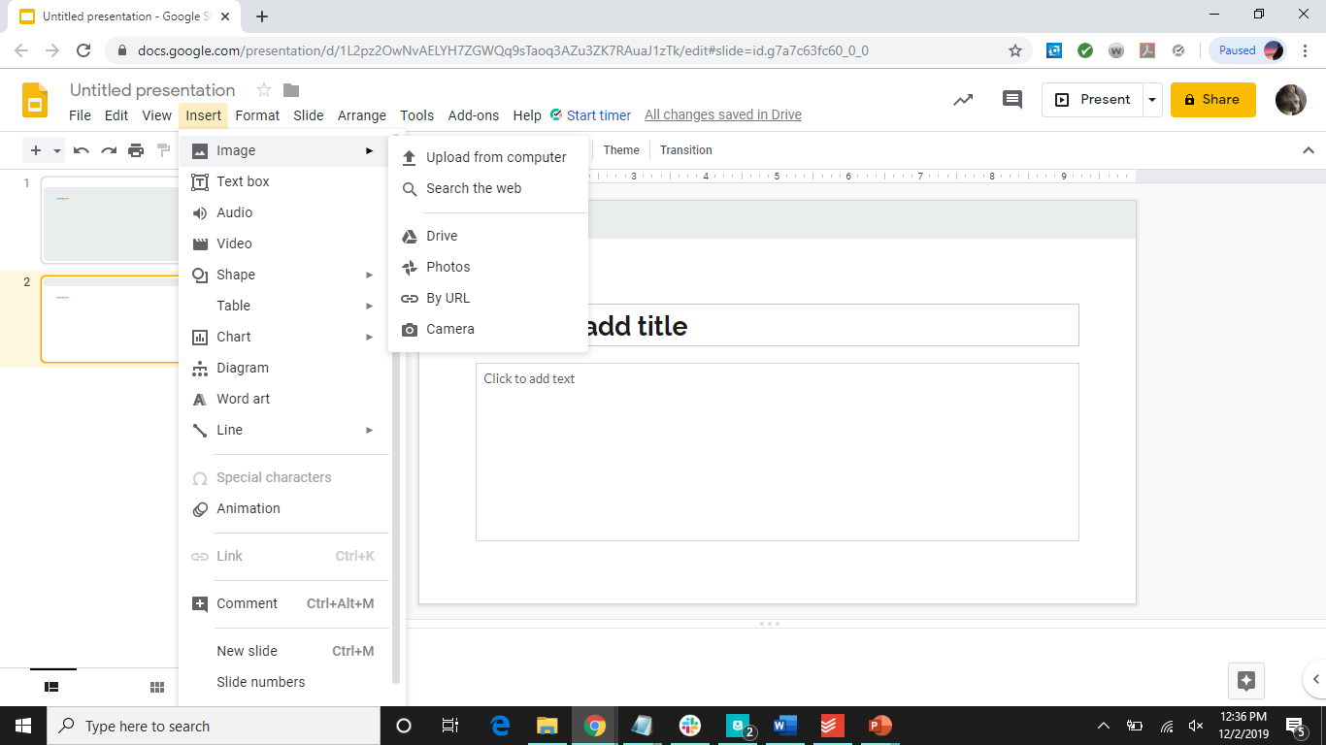
Choose where the image is

Slide 20
Format Images
Crop
Crop to shape
Transparency
Brightness
Contrast
Moving and resizing
Rotate

Slide 21
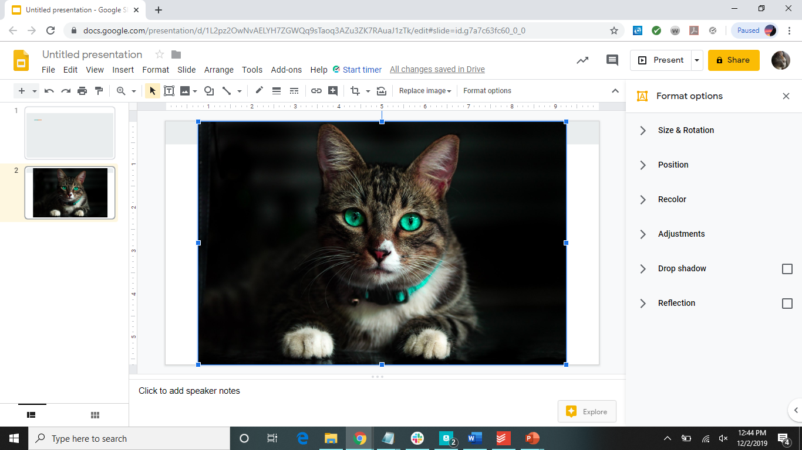
Format Tools

Slide 22
Reorder Objects, Text, and Images
Right-click on the thing you want to reorder
Click on order
Choose the option:
Bring to front
Bring forward
Send backward
Send to back

Slide 23
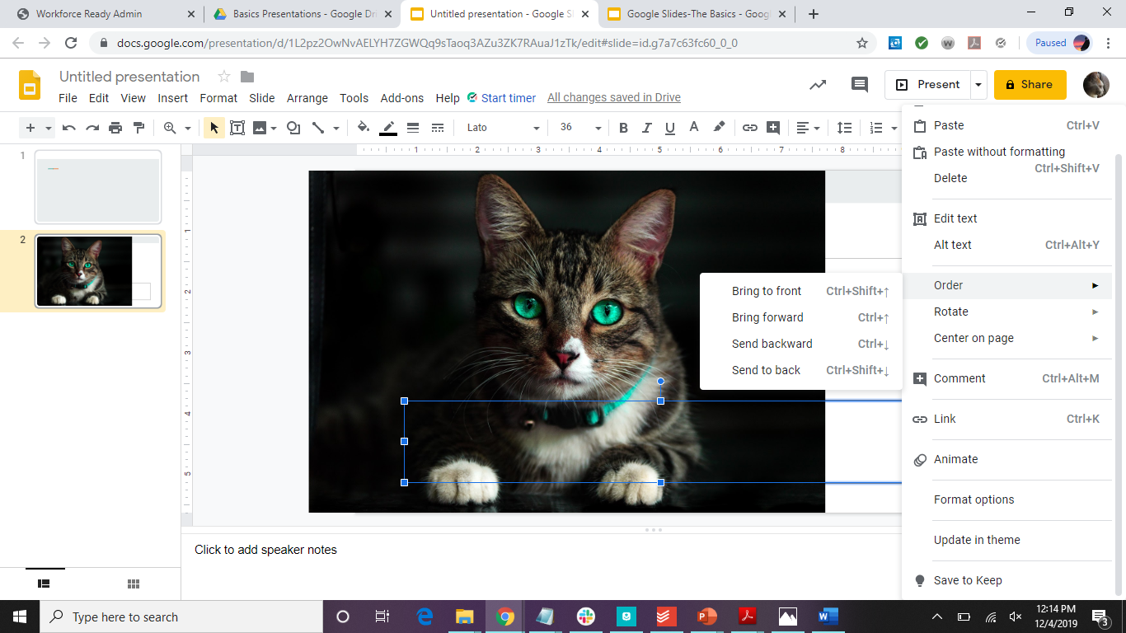

Slide 24
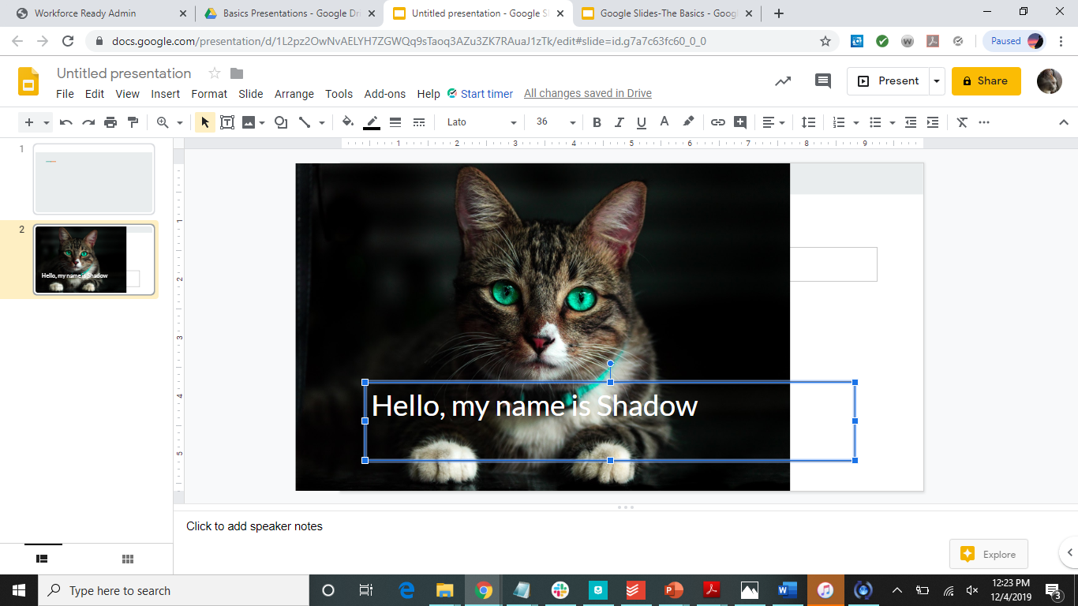

Slide 25
How to Add Videos
Click on the Insert tab
Click on Video
Click where the video is found

Slide 26
Click here

Slide 27
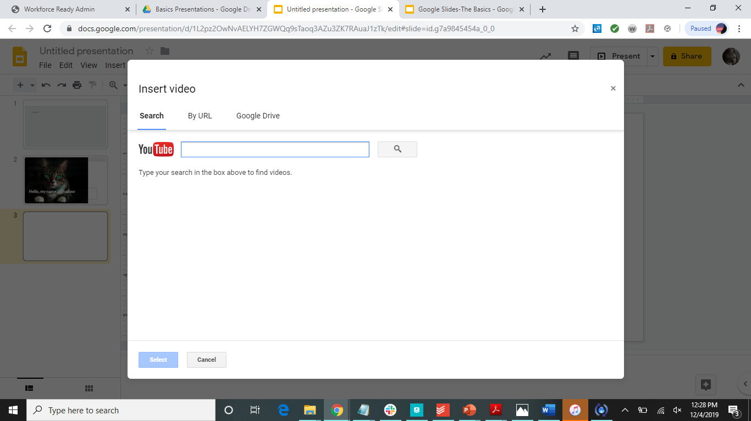

Slide 28
Organizing Slides
Duplicate
Move
Delete

Slide 29
Transitions and Animations
Transitions
Animations
Click on Insert->animation
Click on Slide
Choose the type of transition you would like
Click on Insert->animation
Click on the thing you would like to animate
Choose the type of animation you would like and the timing

Slide 30
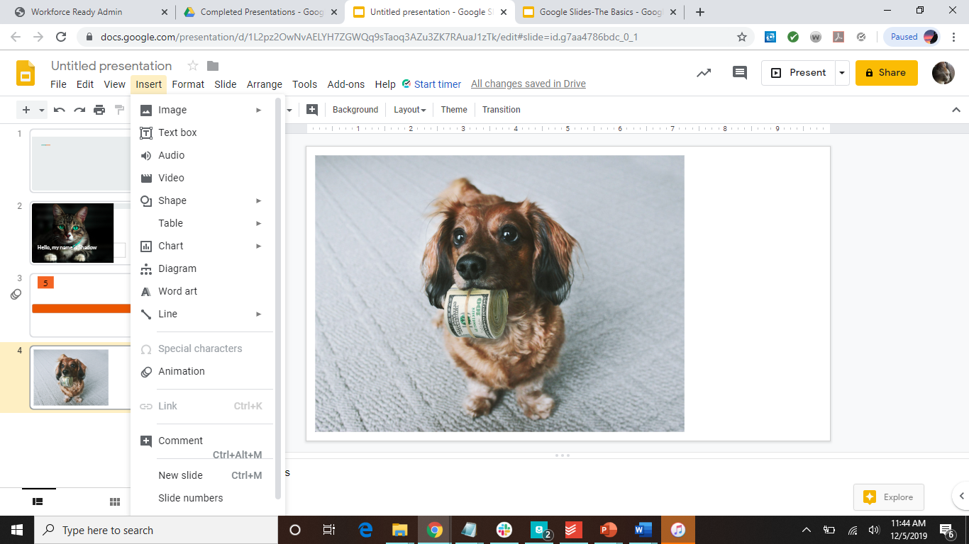

Slide 31
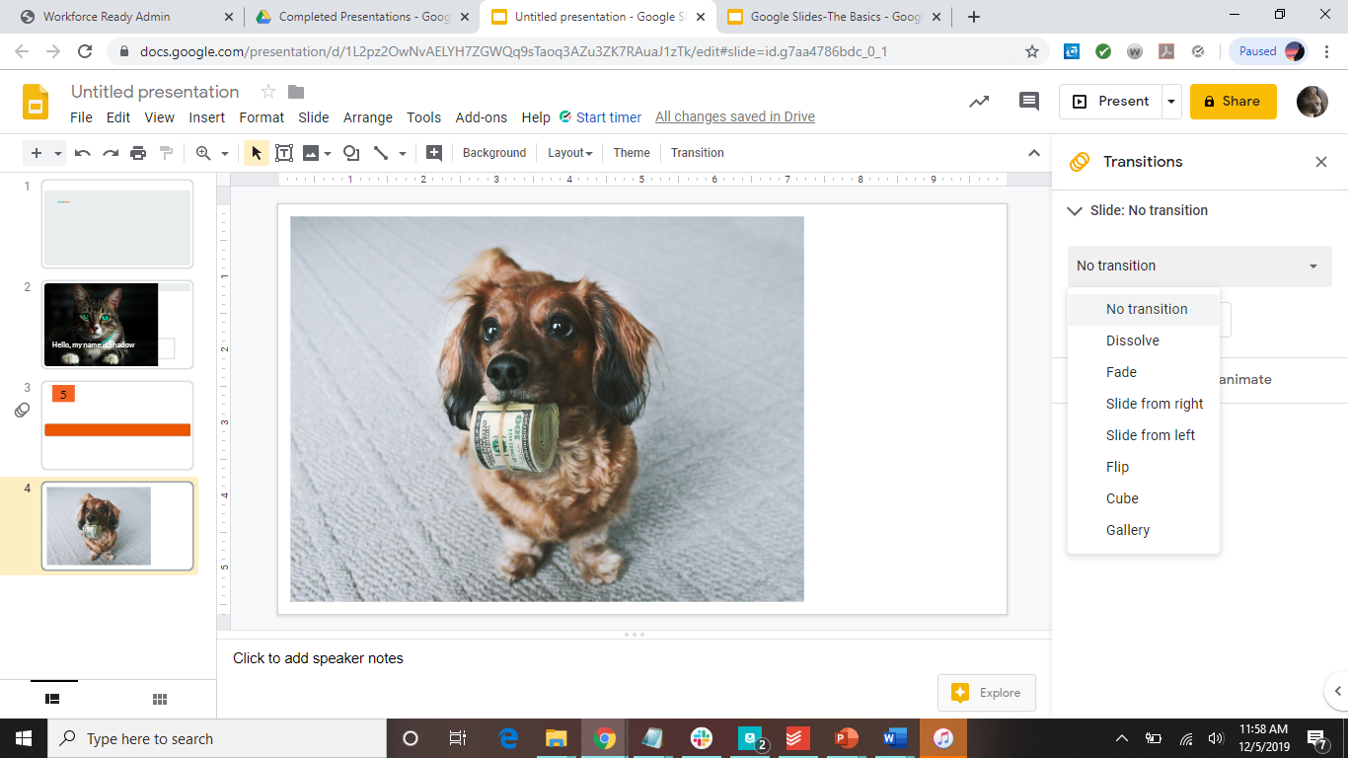

Slide 32
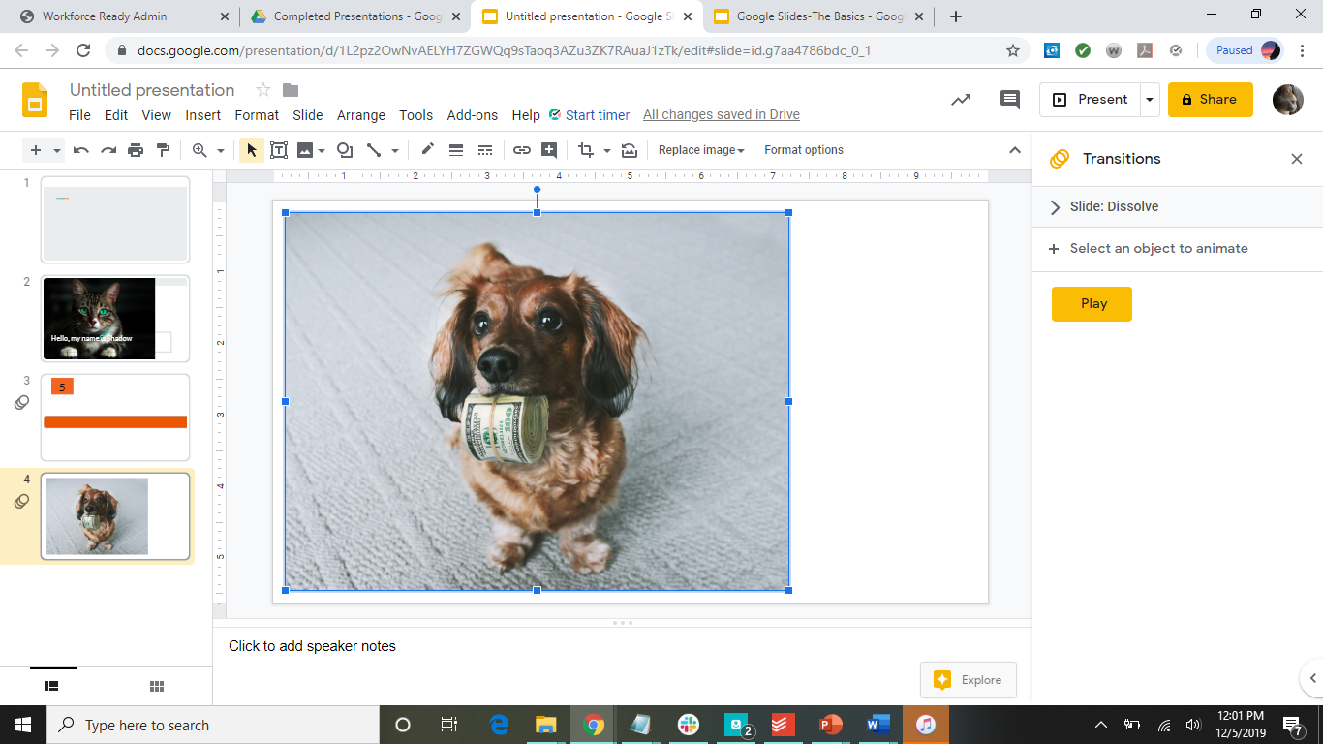

Slide 33
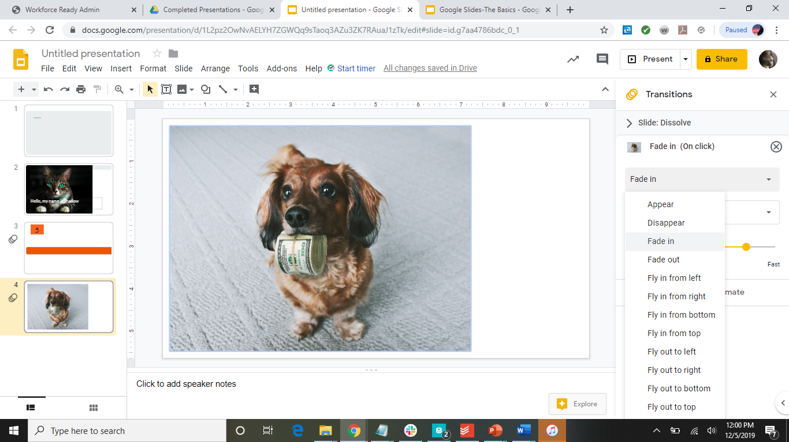

Slide 34
Timer Version 1
1
2
3
4
5
This is five seconds long
Insert text box
Type the number you want to start with in that text box
Format the text box to how you want it
Copy and paste the text box and change the number until you have all the numbers you want
Add exit animation to all of the text boxes in the order of the numbers
Give a one second delay, and have each text box after start automatically
Place the text boxes where you would like them

Slide 35
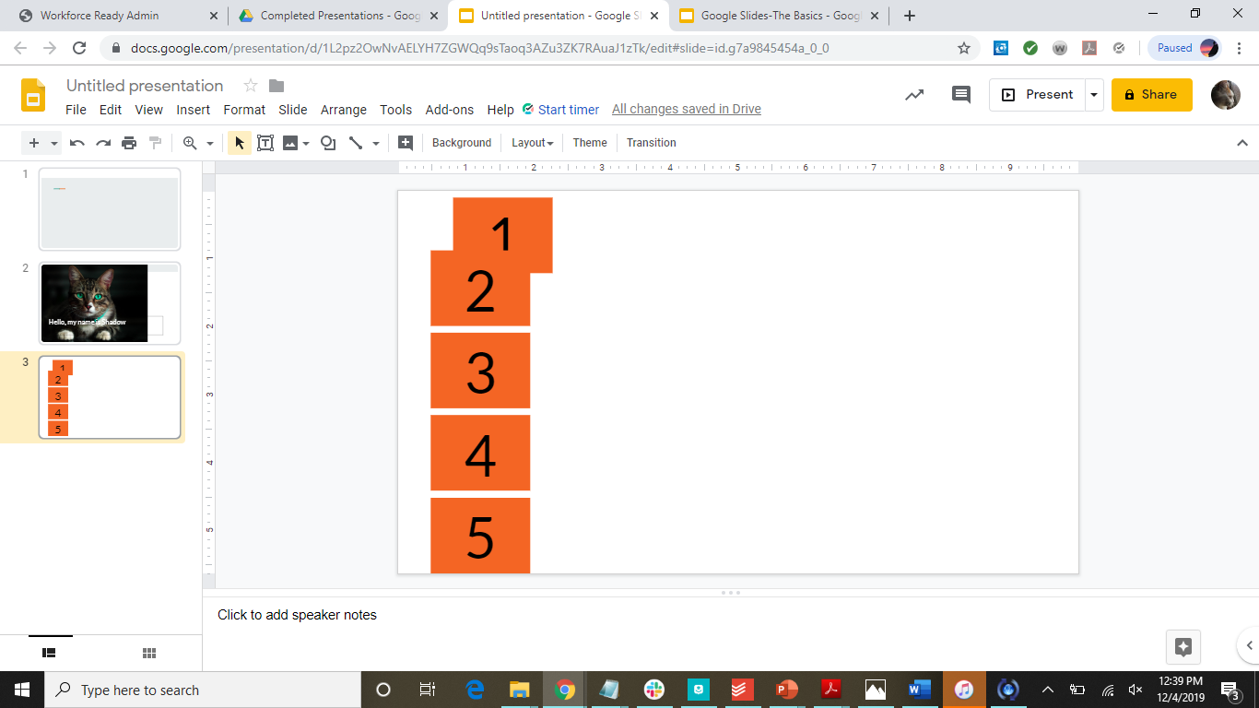

Slide 36
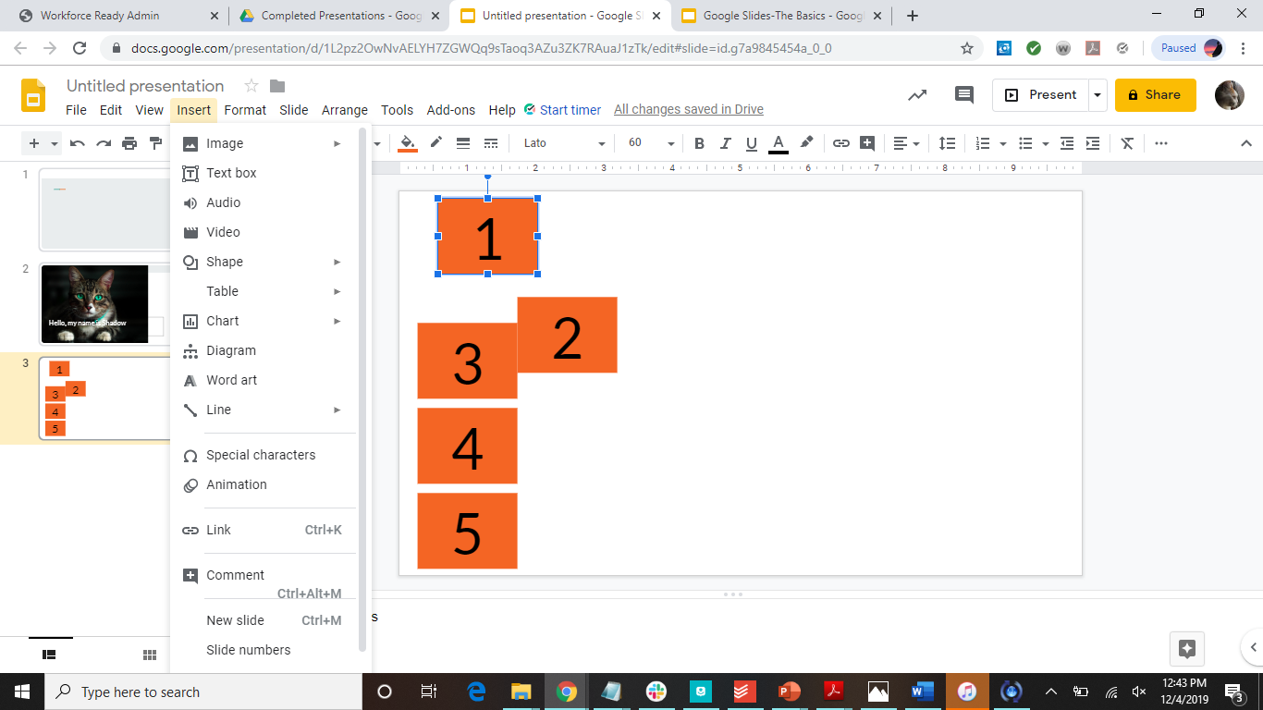

Slide 37
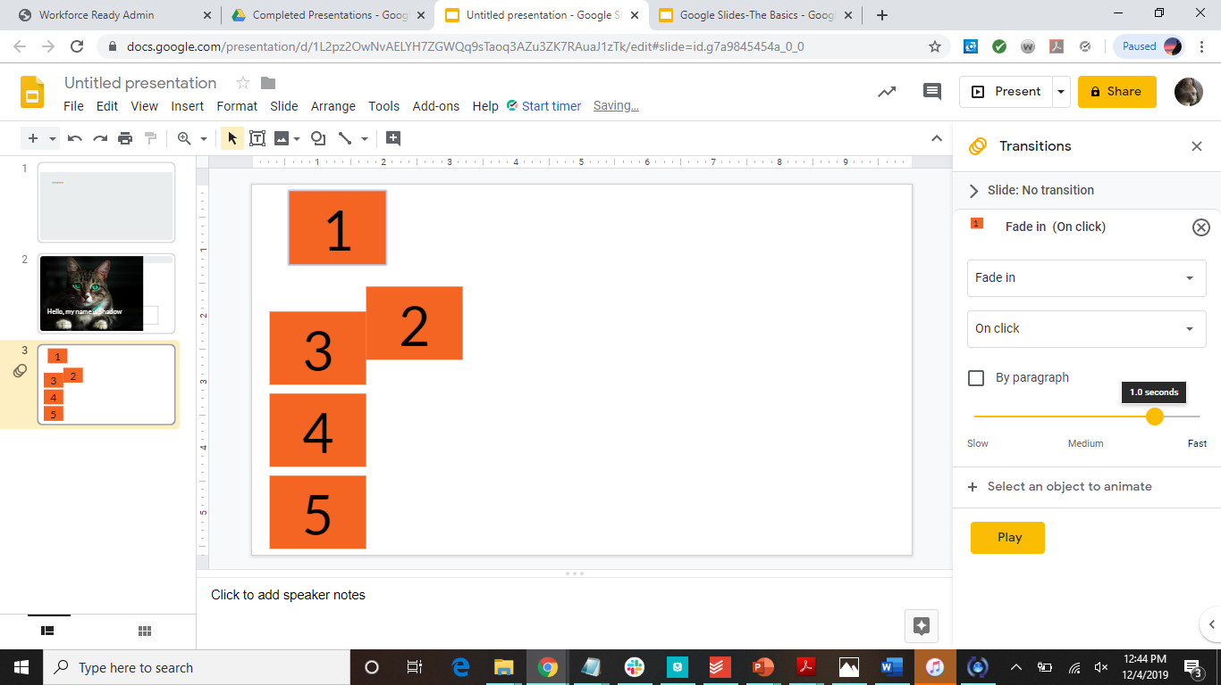

Slide 38
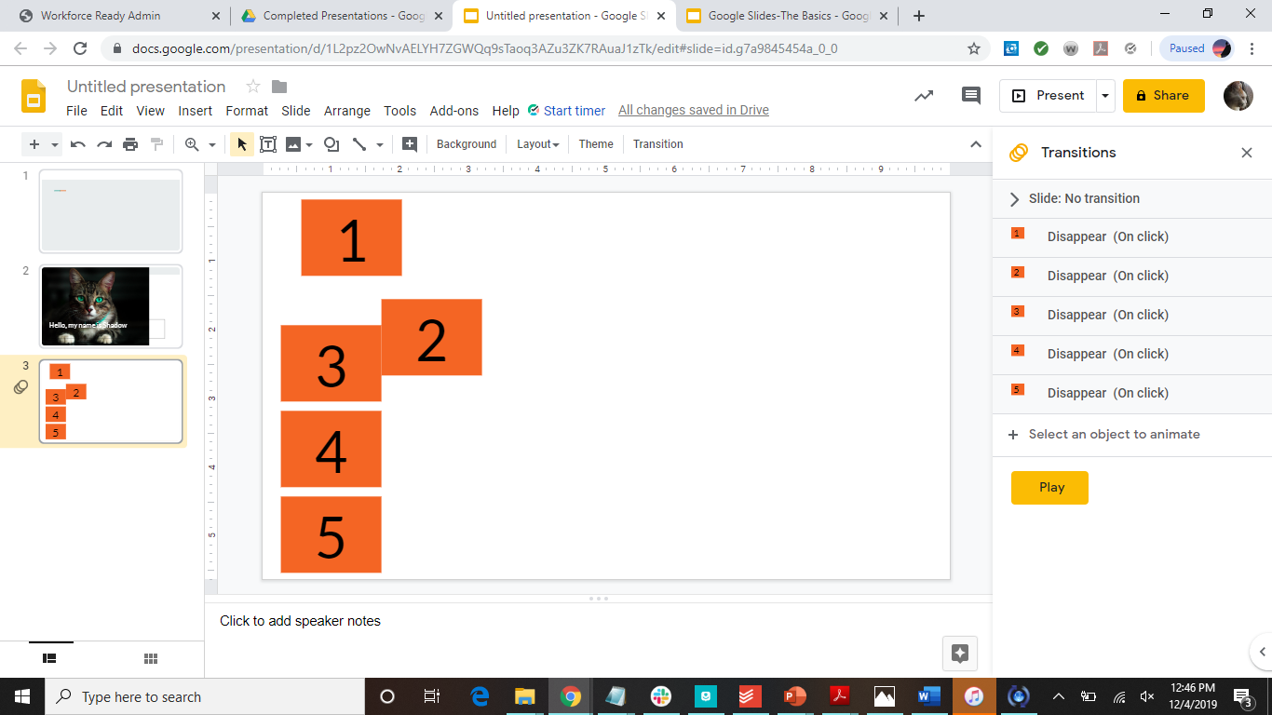

Slide 39


Slide 40
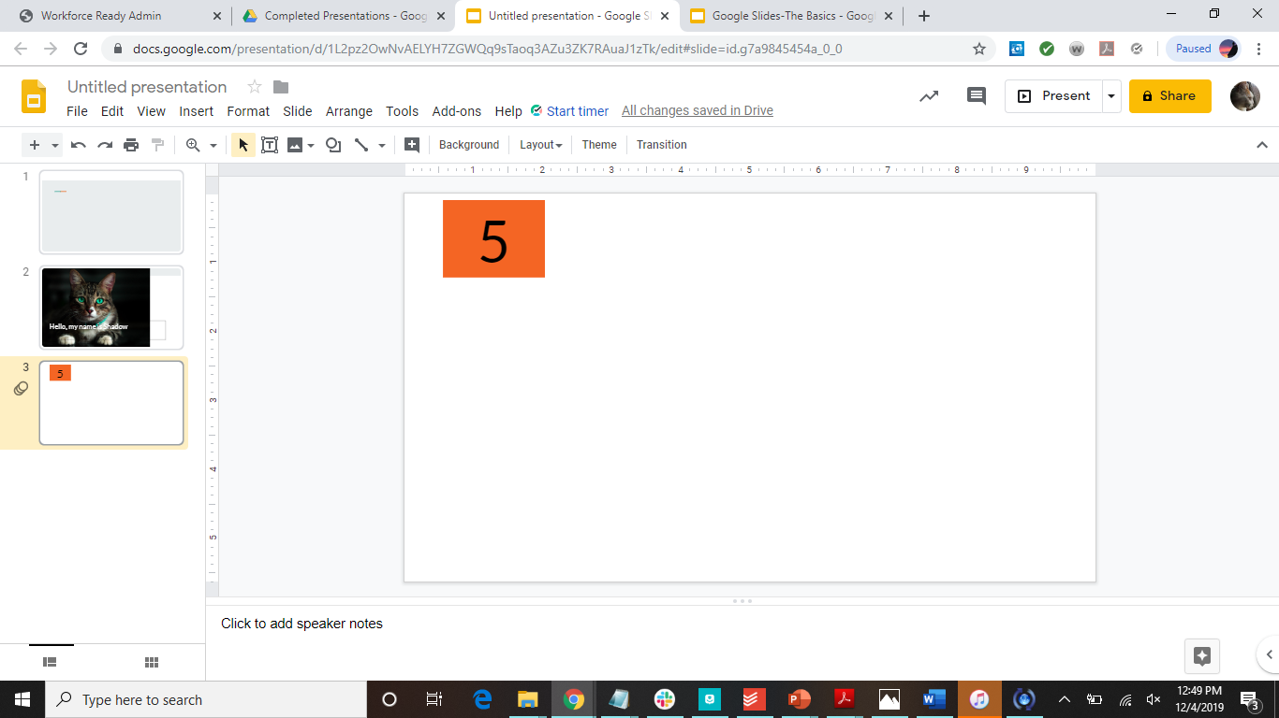

Slide 41
Timer Version 2
Choose a shape for the timer bar
animations->fly out to the left (or right)
Set duration to how long you want the timer to be
This is five seconds long

Slide 42
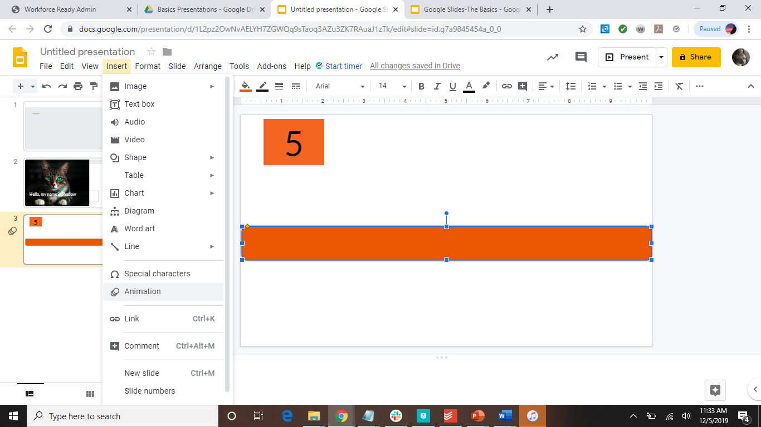

Slide 43
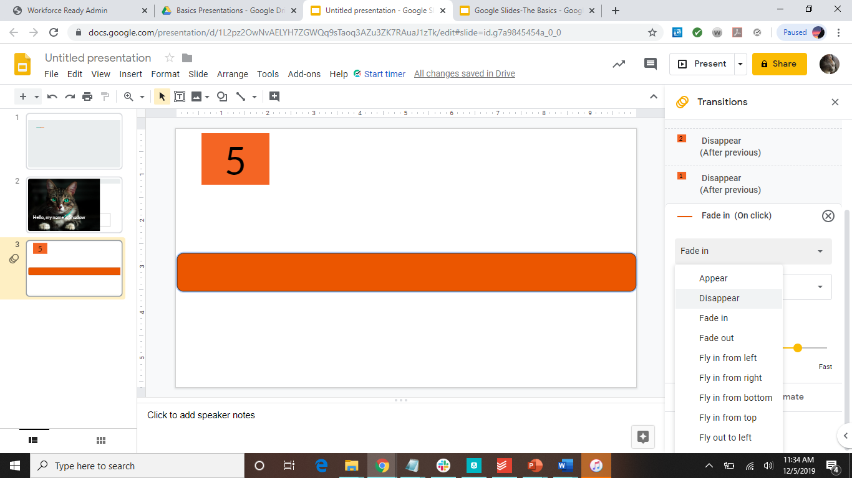

Slide 44
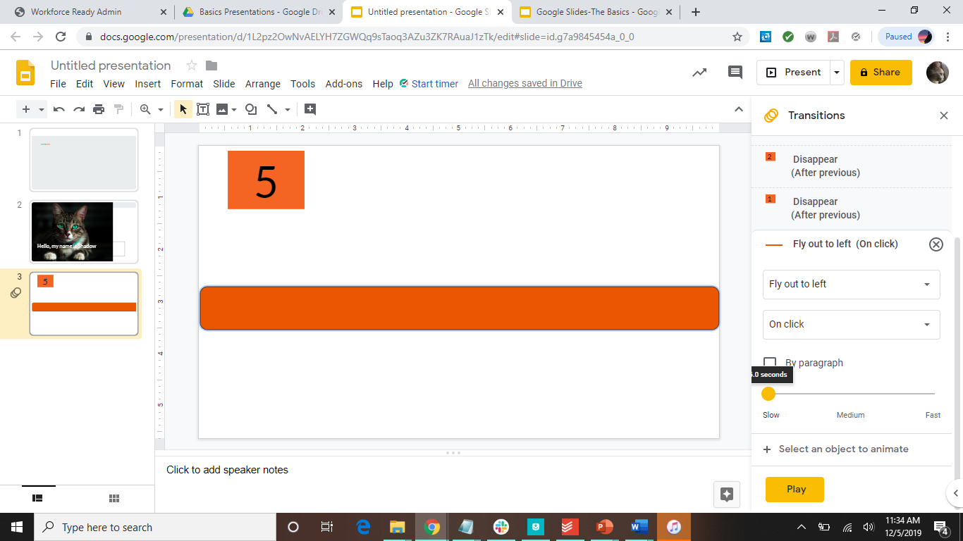

Slide 45
Adding Speaker Notes
Click on the section on the bottom
Add explanations of things that are present on the screen
Why use speaker notes?
Less words on slide=less direct reading
Appear more professional in the presentation

Slide 46
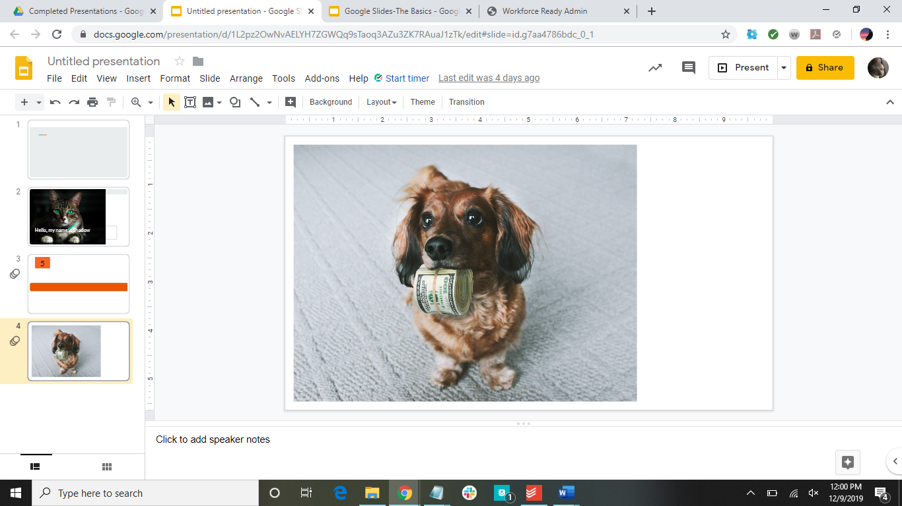
Write notes here

Slide 47
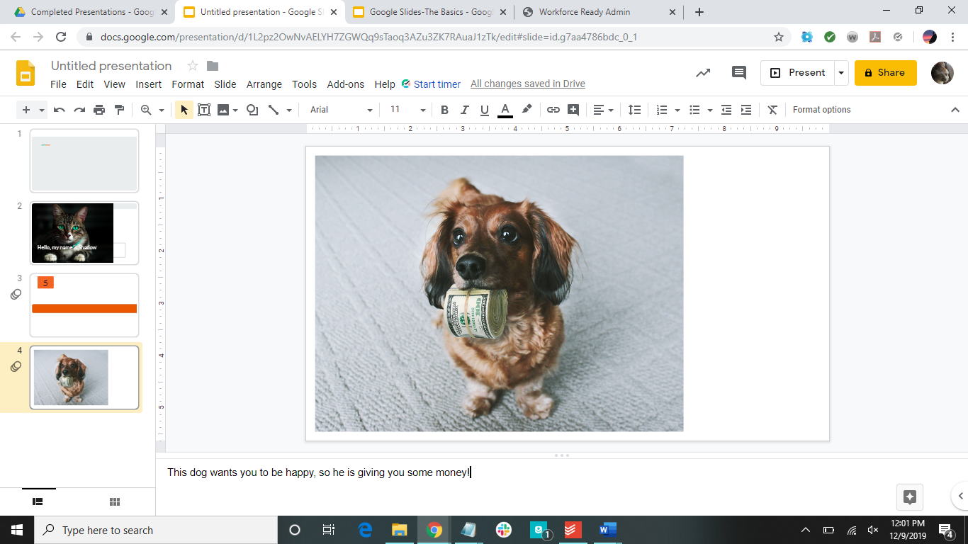

Slide 48
How To Present
For basic presenting, click on “Present”
For other presenting styles, click on the arrow next to “Present” to choose how you want to present

Slide 49
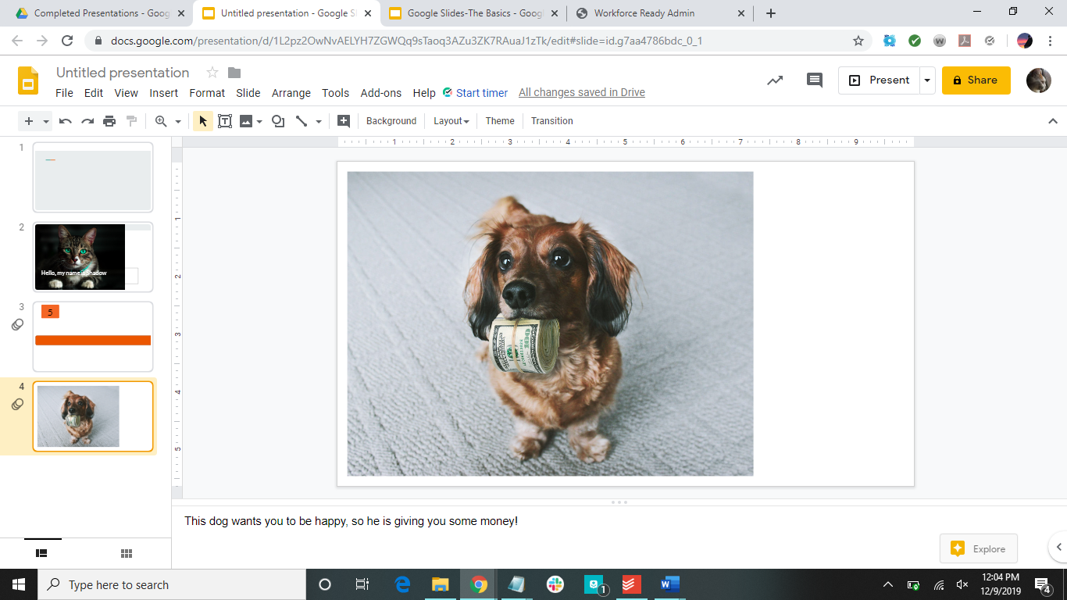
Click here

Slide 50


Slide 51
Helpful Shortcuts
ctrl+I | italicize
ctrl+B | bold
ctrl+U | underline
ctrl+C | copy
ctrl+X | cut
ctrl+Z | undo
ctrl+V | paste
ctrl+F | find

Slide 52
Assignment
Make a Google Slide with your favorite theme. On one slide, insert one of your favorite (appropriate) music videos from YouTube. On another slide, create one of the two timer formats (5 seconds long). On the last slide, add a picture of something you enjoy.

Slide 53
Have more questions?
Email us at ccla@doane.edu or come visit us in Communications 188D from 9am to 5pm.
You can also visit our website at https://www.doane.edu/ccla

Slide 54
References
GCFLearnFree.org. Google Drive and Docs (Google Slides). Retrieved from https://edu.gcfglobal.org/en/googleslides/

Slide 55

Please provide some feedback on the presentation by following the QR Code below.

